Slide 1
Searching in a Graph
Thinking about Algorithms Abstractly
Oswald c
The class notes are a compilation and edition from many sources. The faculty does not claim intellectual property or ownership of the lecture notes. Thanks to them!

Slide 2
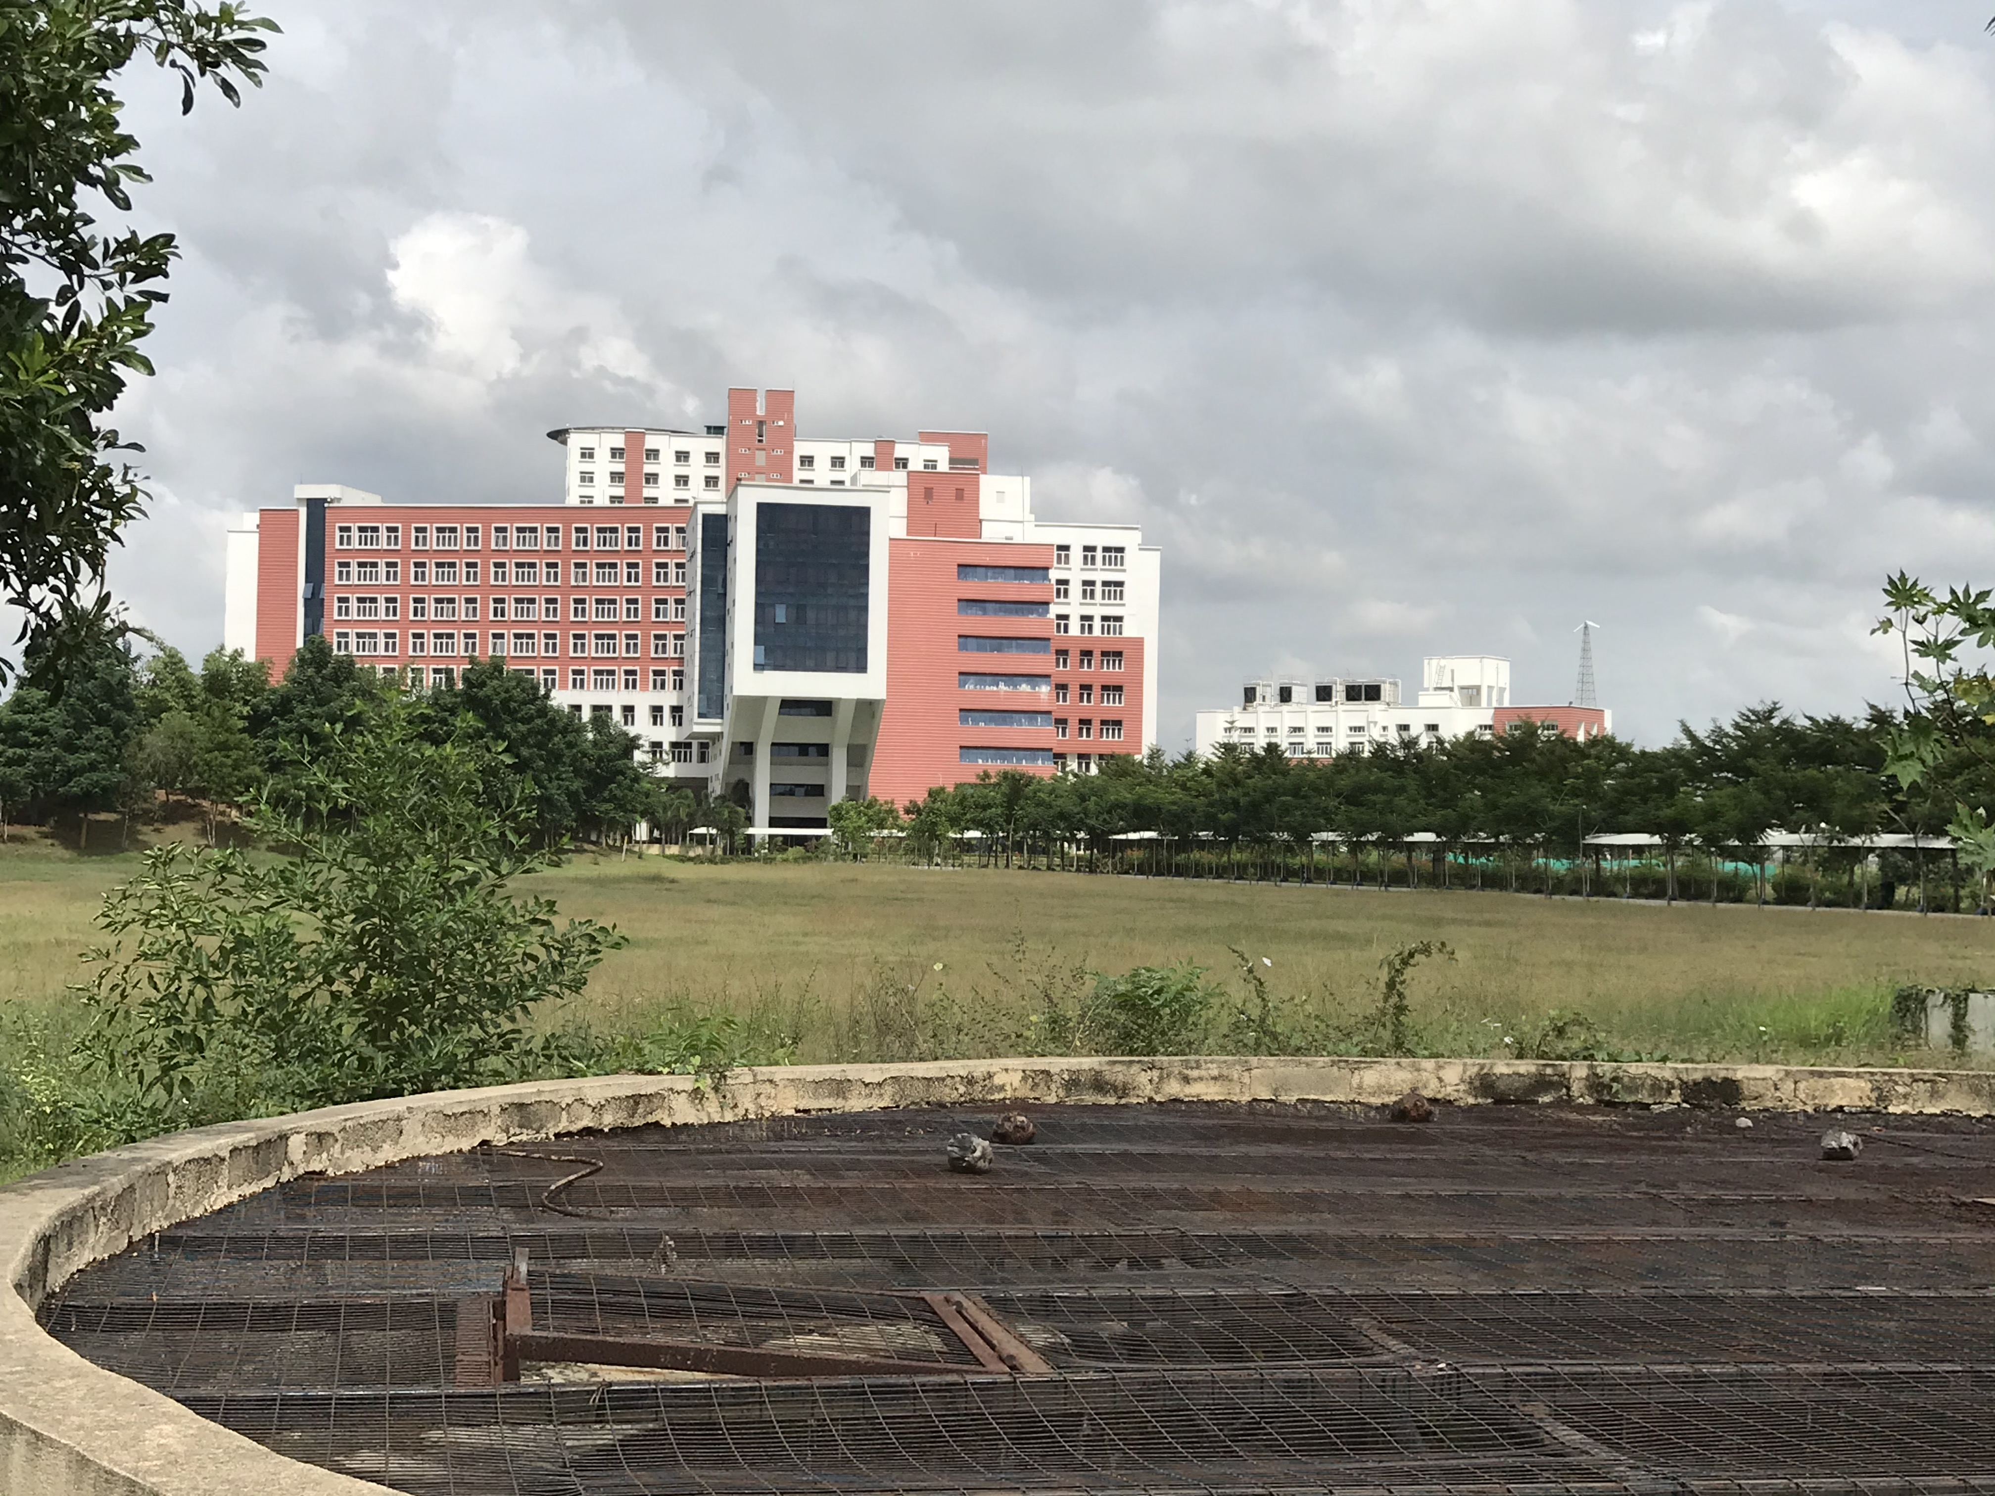

Slide 3
Some Graph Operations
Traversal (this lecture) Given G=(V,E) and vertex v, find all w∈V, such that w connects v.
Depth First Search (DFS) preorder tree traversal/also postorder can be done
Breadth First Search (BFS) level order tree traversal
Connected Components (not in our syllabus)
Spanning Trees (next lecture)

Slide 4
Graph Traversals
Basic Algorithm for Traversals:
Select a starting node
Make a set of nodes adjacent to current node
Visit each node in the set but "mark" each nodes after visiting them so you don't revisit them (and eventually stop)
Repeat above but skip "marked nodes"

Slide 5
In Rough Code Form
traverseGraph(Node start) {
Set pending = emptySet();
pending.add(start)
mark start as visited
while(pending is not empty) {
next = pending.remove()
for each node u adjacent to next
if(u is not marked) {
mark u
pending.add(u)
}
}
}
}

Slide 6
Running Time and Options
Assuming add and remove are O(1), entire traversal is O(|E|) if using an adjacency list
The order we traverse depends entirely on how add and remove work/are implemented
DFS: a stack "depth-first graph search"
BFS: a queue "breadth-first graph search"
DFS and BFS are "big ideas" in computer science
Depth: recursively explore one part before going back to the other parts not yet explored
Breadth: Explore areas closer to start node first

Slide 7
Breadth-First Search (BFS)

Slide 8
The Inventors of BFS…
BFS and its application in finding connected components graphs were invented in 1945 by Konrad Zuse, in his (rejected) Ph.D. thesis on the Plankalkül programming language, but this was not published until 1972. It was reinvented in 1959 by Edward F. Moore, who used it to find the shortest path out of a maze, and later developed by C. Y. Lee into a wire routing algorithm (published 1961)
ref: wiki.org

Slide 9
Breadth first search
Given
a graph G=(V,E) – set of vertices and edges
a distinguished source vertex s
Breadth first search systematically explores the edges of G to discover every vertex that is reachable from s.
It also produces a ‘breadth first tree’ with root s that contains all the vertices reachable from s.
For any vertex v reachable from s, the path in the breadth first tree corresponds to the shortest path in graph G from s to v.
It works on both directed and undirected graphs. However, we will explore only directed graphs.

Slide 10
Breadth first search
It is so named because
It discovers all vertices at distance k from s before discovering vertices at distance k+1.
Animation:
http://en.wikipedia.org/wiki/Image:Animated_BFS.gif

Slide 11
Breadth first search - concepts
To keep track of progress, it colors each vertex - white, gray or black.
All vertices start white.
A vertex discovered first time during the search becomes nonwhite.
All vertices adjacent to black ones are discovered. Whereas, gray ones may have some white adjacent vertices.
Gray represent the frontier between discovered and undiscovered vertices.
Can be done efficiently using a Queue

Slide 12
BFS – How it produces a Breadth first tree
The tree initially contains only root. – s
Whenever a vertex v is discovered in scanning adjacency list of vertex u
Vertex v and edge (u,v) are added to the tree.

Slide 13
BFS - algorithm
BFS(G, s) // G is the graph and s is the starting node
1 for each vertex u ∈ V [G] - {s}
2 do color[u] ← WHITE // color of vertex u
3 d[u] ← ∞ // distance from source s to vertex u
4 π[u] ← NIL // predecessor of u
5 color[s] ← GRAY
6 d[s] ← 0
7 π[s] ← NIL
8 Q ← Ø // Q is a FIFO - queue
9 ENQUEUE(Q, s)
10 while Q ≠ Ø // iterates as long as there are gray vertices. Lines 10-18
11 do u ← DEQUEUE(Q)
12 for each v ∈ Adj[u]
13 do if color[v] = WHITE // discover the undiscovered adjacent vertices
14 then color[v] ← GRAY // enqueued whenever painted gray
15 d[v] ← d[u] + 1
16 π[v] ← u
17 ENQUEUE(Q, v)
18 color[u] ← BLACK // painted black whenever dequeued

Slide 14
Breadth-First Search (BFS)
Not discovered
white
u
0
∞
x
Discovered,
adjacent white nodes
gray
v
∞
∞
y
Discovered,
no adjacent white nodes
black
w
∞
∞
z

Slide 15
Breadth-First Search (BFS)
u
0
∞
x
BFS(G, u):
1. Initialize the graph
color[u] ⬅ gray
π[u] ⬅ Nil
d[u] ⬅ 0
for each other vertex
color[u] ⬅ white
v
∞
∞
y
w
∞
∞
z

Slide 16
Breadth-First Search (BFS)
u
0
∞
x
Q
u
BFS(G, u):
2. Initialize the queue
Q ⬅ Ø
Enqueue(Q, u)
v
∞
∞
y
w
∞
∞
z

Slide 17
Breadth-First Search (BFS)
t = u
u
0
∞
x
Q
BFS(G, u):
3. While Q ≠ Ø
1) t ⬅ Dequeue(Q)
v
∞
∞
y
w
∞
∞
z

Slide 18
Breadth-First Search (BFS)
t = u
r = x, v
u
0
1
x
Q
v
x
BFS(G, u):
3. While Q ≠ Ø
2) for each r adj to t
if color[r] = white
color[r] ⬅ gray
π[r] ⬅ t
d[r] ⬅ d[t] + 1
Enqueue(Q, r)
v
1
∞
y
w
∞
∞
z

Slide 19
Breadth-First Search (BFS)
t = u
r = x, v
u
0
1
x
Q
v
x
BFS(G, u):
3. While Q ≠ Ø
3) color[t] ⬅ black
v
1
∞
y
w
∞
∞
z

Slide 20
Breadth-First Search (BFS)
t = v
u
0
1
x
Q
x
BFS(G, u):
3. While Q ≠ Ø
1) t ⬅ Dequeue(Q)
2) for each r adj to t
…
3) color[t] ⬅ black
v
1
∞
y
w
∞
∞
z

Slide 21
Breadth-First Search (BFS)
t = v
r = y
u
0
1
x
Q
x
y
BFS(G, u):
3. While Q ≠ Ø
1) t ⬅ Dequeue(Q)
2) for each r adj to t
…
3) color[t] ⬅ black
v
1
2
y
w
∞
∞
z

Slide 22
Breadth-First Search (BFS)
t = v
r = y
u
0
1
x
Q
x
y
BFS(G, u):
3. While Q ≠ Ø
1) t ⬅ Dequeue(Q)
2) for each r adj to t
…
3) color[t] ⬅ black
v
1
2
y
w
∞
∞
z

Slide 23
Breadth-First Search (BFS)
t = x
r =
u
0
1
x
Q
y
BFS(G, u):
3. While Q ≠ Ø
1) t ⬅ Dequeue(Q)
2) for each r adj to t
…
3) color[t] ⬅ black
v
1
2
y
w
∞
∞
z

Slide 24
Breadth-First Search (BFS)
t = y
r = w
u
0
1
x
Q
w
BFS(G, u):
3. While Q ≠ Ø
1) t ⬅ Dequeue(Q)
2) for each r adj to t
…
3) color[t] ⬅ black
v
1
2
y
w
3
∞
z

Slide 25
Breadth-First Search (BFS)
t = w
r = z
u
0
1
x
Q
z
BFS(G, u):
3. While Q ≠ Ø
1) t ⬅ Dequeue(Q)
2) for each r adj to t
…
3) color[t] ⬅ black
v
1
2
y
w
3
4
z

Slide 26
Breadth-First Search (BFS)
t = z
r =
u
0
1
x
Q
BFS(G, u):
3. While Q ≠ Ø
1) t ⬅ Dequeue(Q)
2) for each r adj to t
…
3) color[t] ⬅ black
v
1
2
y
w
3
4
z

Slide 27
Breadth-First Search (BFS)
u
0
1
x
BFS(G, u):
- the shortest-path distance
from u
v
1
2
y
w
3
4
z

Slide 28
Breadth-First Search (BFS)
u
0
1
x
BFS(G, u):
- the shortest-path distance
from u
- construct a tree
v
1
2
y
w
3
4
z

Slide 29
Breadth-First Search (BFS)
u
0
1
x
BFS(G, u):
- Initialization: |V|
- Enqueuing/dequeuing:
|V|
- Scanning adj vertices: |E|
v
1
2
y
w
3
4
z

Slide 30
Breadth-First Search (BFS)
u
0
1
x
BFS(G, u):
- Initialization: O(|V|)
- Enqueuing/dequeuing:
O(|V|)
- Scanning adjacent vertices:
O(|E|)
=> total running time:
O(|V| + |E|)
v
1
2
y
w
3
4
z

Slide 31
Breadth first search - analysis
Enqueue and Dequeue happen only once for each node. - O(V).
Sum of the lengths of adjacency lists – θ(E) (for a directed graph)
Initialization overhead O(V)
Total runtime O(V+E)

Slide 32
Breadth-First Traversal Implementation
bfs(v)
count ← count + 1
mark v with count
initialize queue with v
while queue is not empty do
a ← front of queue
for each vertex w adjacent to a do
if w is marked with 0
count ←count + 1
mark w with count
add w to the end of the queue
remove a from the front of the queue
BFS(G)
count ← 0
mark each vertex with 0
for each vertex v in V do
if v is marked with 0
bfs(v)

Slide 33
Breadth-First Traversal Implementation (Cont’d)
public void breadthFirstTraversal(Visitor visitor, Vertex start){
boolean enqueued[] = new boolean[numberOfVertices];
for(int i = 0; i < numberOfVertices; i++) enqueued[i] = false;
Queue queue = new QueueAsLinkedList();
enqueued[getIndex(start)] = true;
queue.enqueue(start);
while(!queue.isEmpty() && !visitor.isDone()) {
Vertex v = (Vertex) queue.dequeue();
visitor.visit(v);
Iterator it = v.getSuccessors();
while(it.hasNext()) {
Vertex to = (Vertex) it.next();
int index = getIndex(to);
if(!enqueued[index]) {
enqueued[index] = true;
queue.enqueue(to);
}
}
}
}

Slide 34
BFS observations
optimality:
always finds the shortest path (fewest edges).
in unweighted graphs, finds optimal cost path.
In weighted graphs, not always optimal cost.
retrieval: harder to reconstruct the actual sequence of vertices or edges in the path once you find it
conceptually, BFS is exploring many possible paths in parallel, so it's not easy to store a path array/list in progress
solution: We can keep track of the path by storing predecessors for each vertex (each vertex can store a reference to a previous vertex).
DFS uses less memory than BFS, easier to reconstruct the path once found; but DFS does not always find shortest path. BFS does.
a
b
c
d
e
f
g
h

Slide 35
Depth first search
It searches ‘deeper’ the graph when possible.
Starts at the selected node and explores as far as possible along each branch before backtracking.
Vertices go through white, gray and black stages of color.
White – initially
Gray – when discovered first
Black – when finished i.e. the adjacency list of the vertex is completely examined.
Also records timestamps for each vertex
d[v] when the vertex is first discovered
f[v] when the vertex is finished
Can be done efficiently using a Stack

Slide 36
Inventor of DFS
It appears that a version of depth-first search was investigated in the 19th century by French mathematician Charles Pierre Trémaux (Trémaux tree) as a strategy for solving mazes.

Slide 37
Depth-First Search (DFS)

Slide 38
Depth-First Search (DFS)
d[u]: when u is discovered
f[u]: when searching adj of u
is finished
u
v
w

Slide 39
Depth-First Search (DFS)
timestamp: t
d[u]: when u is discovered
f[u]: when searching adj of u
is finished
d[u] = t
u
v
w

Slide 40
Depth-First Search (DFS)
timestamp: t+1
d[u]: when u is discovered
f[u]: when searching adj of u
is finished
d[u] = t
u
v
w
d[v] = t+1

Slide 41
Depth-First Search (DFS)
timestamp: t+2
d[u]: when u is discovered
f[u]: when searching adj of u
is finished
d[u] = t
u
v
w
d[v] = t+1
f[v] = t+2

Slide 42
Depth-First Search (DFS)
timestamp: t+3
d[u]: when u is discovered
f[u]: when searching adj of u
is finished
d[u] = t
u
v
w
d[v] = t+1
f[v] = t+2
d[w] = t+3

Slide 43
Depth-First Search (DFS)
timestamp: t+4
d[u]: when u is discovered
f[u]: when searching adj of u
is finished
d[u] = t
u
v
w
d[v] = t+1
f[v] = t+2
d[w] = t+3
f[v] = t+4

Slide 44
Depth-First Search (DFS)
timestamp: t+5
d[u]: when u is discovered
f[u]: when searching adj of u
is finished
d[u] = t
f[u] = t+5
u
v
w
d[v] = t+1
f[v] = t+2
d[w] = t+3
f[w] = t+4

Slide 45
Depth-First Search (DFS)
d[u]: when u is discovered
f[u]: when searching adj of u
is finished
d[u] = t
f[u] = t+5
u
d[u] < f[u]
[ d[u], f[u] ] entirely contains [ d[v], f[v] ]
[ d[v], f[v] ] and [ d[w], f[w] ] are entirely disjoint
v
w
d[v] = t+1
f[v] = t+2
d[w] = t+3
f[w] = t+4

Slide 46
Depth-First Search (DFS)
Not discovered
white
u
x
Discovered,
adjacent white nodes
gray
v
y
Discovered,
no adjacent white nodes
black
w
z

Slide 47
Depth-First Search (DFS)
Not discovered
u
x
Discovered,
adjacent white nodes
d /
v
y
Discovered,
no adjacent white nodes
d / f
w
z

Slide 48
Depth-First Search (DFS)
u
x
DFS(G):
1. Initialization
for each u V[G],
color[u] ⬅ white
π[u] ⬅ Nil
time ⬅ 0
v
y
w
z

Slide 49
Depth-First Search (DFS)
u
1/
x
DFS(G):
1. Initialization
2. For each u V[G]
if color[u] = white
DFS-Visit(u)
v
y
DFS-Visit(u):
1. Initial Setting
color[u] ⬅ gray
d[u] ⬅ time ⬅ time + 1
w
z

Slide 50
Depth-First Search (DFS)
u
1/
x
DFS(G):
1. Initialization
2. For each u V[G]
if color[u] = white
DFS-Visit(u)
v
2/
y
DFS-Visit(u):
1. Initial Setting
2. for each adj v of white
π[v] ⬅ u
DFS-Visit[v]
w
z

Slide 51
Depth-First Search (DFS)
u
1/
x
DFS(G):
1. Initialization
2. For each u V[G]
if color[u] = white
DFS-Visit(u)
v
2/
3/
y
DFS-Visit(u):
1. Initial Setting
2. for each adj v of white
π[v] ⬅ u
DFS-Visit[v]
w
z

Slide 52
Depth-First Search (DFS)
u
1/
4/
x
DFS(G):
1. Initialization
2. For each u V[G]
if color[u] = white
DFS-Visit(u)
v
2/
3/
y
DFS-Visit(u):
1. Initial Setting
2. for each adj v of white
π[v] ⬅ u
DFS-Visit[v]
w
z

Slide 53
Depth-First Search (DFS)
u
1/
4/5
x
DFS(G):
1. Initialization
2. For each u V[G]
if color[u] = white
DFS-Visit(u)
v
2/
3/
y
DFS-Visit(u):
1. Initial Setting
2. Handling adj vertices
3. color[u] ⬅ black
f[u] ⬅ time ⬅ time + 1
w
z

Slide 54
Depth-First Search (DFS)
u
1/
4/5
x
DFS(G):
1. Initialization
2. For each u V[G]
if color[u] = white
DFS-Visit(u)
v
2/
3/6
y
DFS-Visit(u):
1. Initial Setting
2. Handling adj vertices
3. color[u] ⬅ black
f[u] ⬅ time ⬅ time + 1
w
z

Slide 55
Depth-First Search (DFS)
u
1/
4/5
x
DFS(G):
1. Initialization
2. For each u V[G]
if color[u] = white
DFS-Visit(u)
v
2/7
3/6
y
DFS-Visit(u):
1. Initial Setting
2. Handling adj vertices
3. color[u] ⬅ black
f[u] ⬅ time ⬅ time + 1
w
z

Slide 56
Depth-First Search (DFS)
u
1/8
4/5
x
DFS(G):
1. Initialization
2. For each u V[G]
if color[u] = white
DFS-Visit(u)
v
2/7
3/6
y
DFS-Visit(u):
1. Initial Setting
2. Handling adj vertices
3. color[u] ⬅ black
f[u] ⬅ time ⬅ time + 1
w
z

Slide 57
Depth-First Search (DFS)
u
1/8
4/5
x
DFS(G):
1. Initialization
2. For each u V[G]
if color[u] = white
DFS-Visit(u)
v
2/7
3/6
y
DFS-Visit(u):
1. Initial Setting
2. Handling adj vertices
3. color[u] ⬅ black
f[u] ⬅ time ⬅ time + 1
w
9/
z

Slide 58
Depth-First Search (DFS)
u
1/8
4/5
x
DFS(G):
1. Initialization
2. For each u V[G]
if color[u] = white
DFS-Visit(u)
v
2/7
3/6
y
DFS-Visit(u):
1. Initial Setting
2. Handling adj vertices
3. color[u] ⬅ black
f[u] ⬅ time ⬅ time + 1
w
9/
10/
z

Slide 59
Depth-First Search (DFS)
u
1/8
4/5
x
DFS(G):
1. Initialization
2. For each u V[G]
if color[u] = white
DFS-Visit(u)
v
2/7
3/6
y
DFS-Visit(u):
1. Initial Setting
2. Handling adj vertices
3. color[u] ⬅ black
f[u] ⬅ time ⬅ time + 1
w
9/
10/11
z

Slide 60
Depth-First Search (DFS)
u
1/8
4/5
x
DFS(G):
1. Initialization
2. For each u V[G]
if color[u] = white
DFS-Visit(u)
v
2/7
3/6
y
DFS-Visit(u):
1. Initial Setting
2. Handling adj vertices
3. color[u] ⬅ black
f[u] ⬅ time ⬅ time + 1
w
9/12
10/11
z

Slide 61
Depth-First Search (DFS)
u
1/8
4/5
x
DFS(G):
- construct a forest
v
2/7
3/6
y
w
9/12
10/11
z

Slide 62
Depth-First Search (DFS)
u
1/8
4/5
x
DFS(G):
- Initialization: O(|V|)
- Traversing vertices: O(|V|)
- Scanning adjacent vertices:
O(|E|)
=> total running time:
O(|V| + |E|)
v
2/7
3/6
y
w
9/12
10/11
z

Slide 63
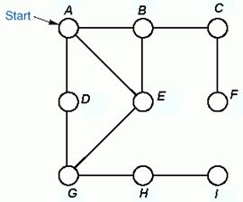
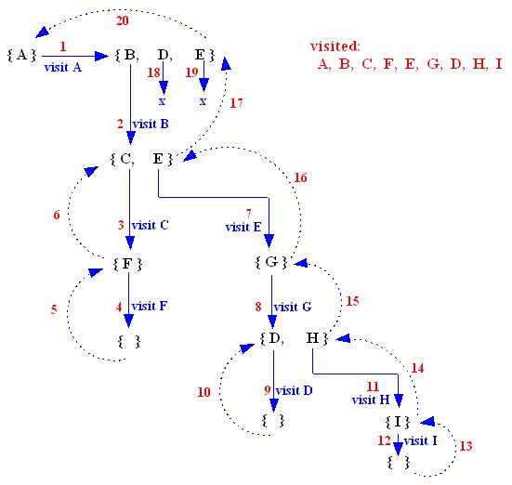
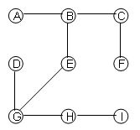
Recursive preorder Depth-First Traversal Tracing – Example 2
At each stage, a set of unvisited adjacent vertices of the current vertex is generated.
The Preorder Depth First Tree:

Slide 64
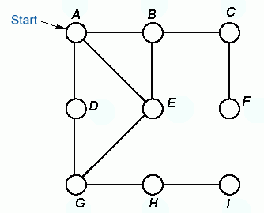


Example - 3
Depth-first traversal using an explicit stack.
The Preorder Depth First Tree:
Order of
Traversal
A B C F E G D H I
Stack
Note: The DFS-tree for undirected graph is a free tree

Slide 65
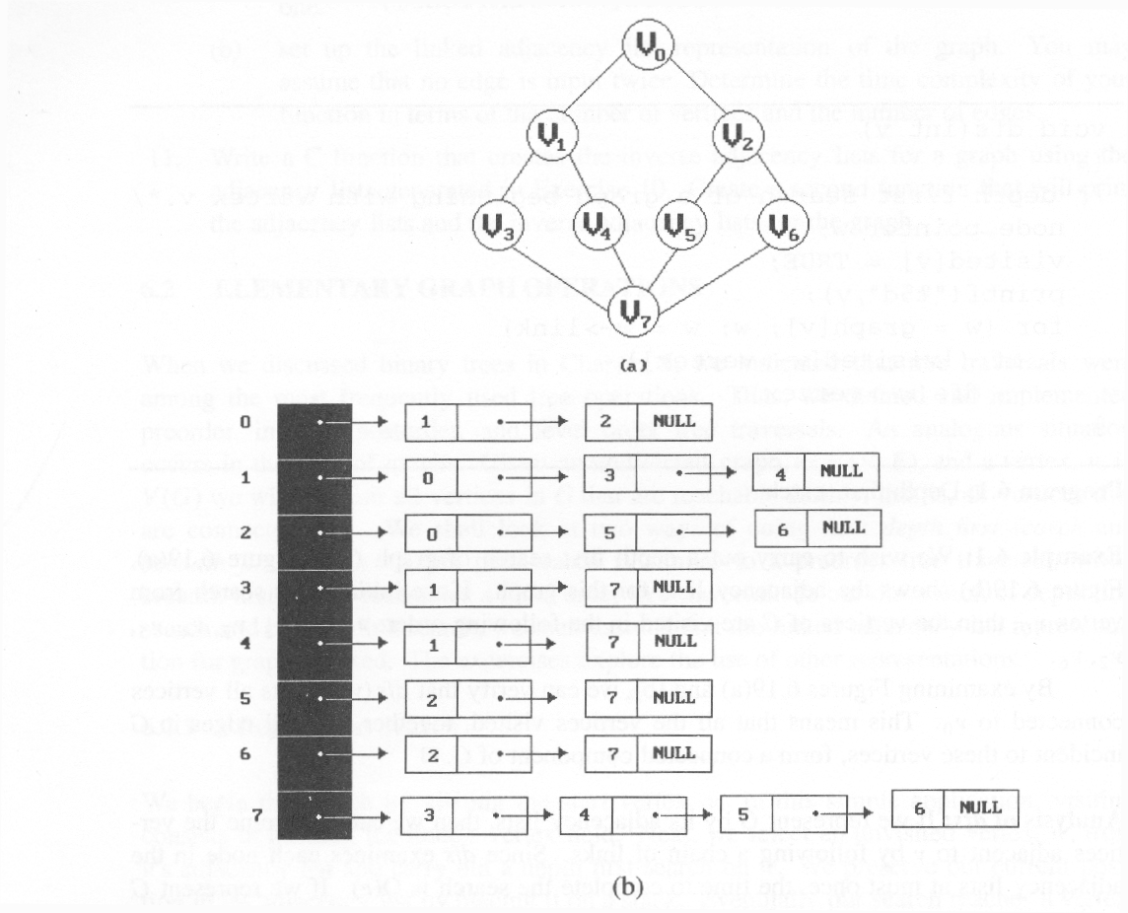
Find DFS:

Slide 66
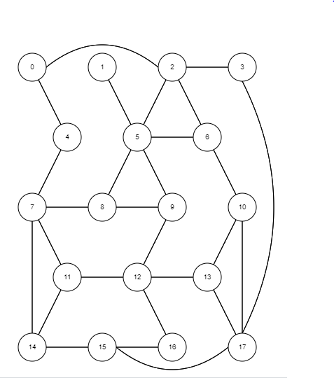
Try BFS and DFS

Slide 67
Recursive preorder Depth-First Traversal Implementation
#Using a Stack:
DFS(Node start) {
initialize stack s to hold start
mark start as visited
while(s is not empty) {
next = s.pop() // and "process"
for each node u adjacent to next
if(u is not marked)
mark u and push onto s
}
}
dfsPreorder(v){
visit v;
for(each neighbour w of v)
if(w has not been visited)
dfsPreorder(w);
}
The following is the code for the recursive preorderDepthFirstTraversal method of the AbstractGraph class:
public void preorderDepthFirstTraversal(Visitor visitor, Vertex start)
{
boolean visited[] = new boolean[numberOfVertices];
for(int v = 0; v < numberOfVertices; v++)
visited[v] = false;
preorderDepthFirstTraversal(visitor, start, visited);
}

Slide 68
Recursive preorder Depth-First Traversal Implementation (cont’d)
private void preorderDepthFirstTraversal(Visitor visitor,
Vertex v, boolean[] visited)
{
if(visitor.isDone())
return;
visitor.visit(v);
visited[getIndex(v)] = true;
Iterator p = v.getSuccessors();
while(p.hasNext()) {
Vertex to = (Vertex) p.next();
if(! visited[getIndex(to)])
preorderDepthFirstTraversal(visitor, to, visited);
}
}

Slide 69
Depth first search - algorithm
DFS(G)
1 for each vertex u ∈ V [G]
2 do color[u] ← WHITE // color all vertices white, set their parents NIL
3 π[u] ← NIL
4 time ← 0 // zero out time
5 for each vertex u ∈ V [G] // call only for unexplored vertices
6 do if color[u] = WHITE // this may result in multiple sources
7 then DFS-VISIT(u)
DFS-VISIT(u)
1 color[u] ← GRAY ▹White vertex u has just been discovered.
2 time ← time +1
3 d[u] time // record the discovery time
4 for each v ∈ Adj[u] ▹Explore edge(u, v).
5 do if color[v] = WHITE
6 then π[v] ← u // set the parent value
7 DFS-VISIT(v) // recursive call
8 color[u] BLACK ▹ Blacken u; it is finished.
9 f [u] ▹ time ← time +1

Slide 70
Depth first search - analysis
Lines 1-3, initialization take time Θ(V).
Lines 5-7 take time Θ(V), excluding the time to call the DFS-VISIT.
DFS-VISIT is called only once for each node (since it’s called only for white nodes and the first step in it is to paint the node gray).
Loop on line 4-7 is executed |Adj(v)| times. Since, ∑_{vєV} |Adj(v)| = Ө (E), the total cost of DFS-VISIT it θ(E)
The total cost of DFS is θ(V+E)

Slide 71
DFS observations
discovery: DFS is guaranteed to find a path if one exists.
retrieval: It is easy to retrieve exactly what the path is (the sequence of edges taken) if we find it
optimality: not optimal. DFS is guaranteed to find a path, not necessarily the best/shortest path
Example: dfs(a, f) returns {a, d, c, f} rather than {a, d, f}.
a
b
c
d
e
f
g
h

Slide 72
DFS/BFS Comparison
BFS always finds the shortest path (or "optimal solution") from the starting node to a target node
Storage for BFS can be extremely large
A k-nary tree of height h could result in a queue size of k^{h}
DFS can use less space in finding a path
If longest path in the graph is p and highest out-degree is d then DFS stack never has more than d⋅p elements

Slide 73
Implications
For large graphs, DFS is hugely more memory efficient, if we can limit the maximum path length to some fixed d.
If we knew the distance from the start to the goal in advance, we could simply not add any children to stack after level d
But what if we don’t know d in advance?

Slide 74
BFS and DFS – possible applications
Exploration algorithms in Artificial Intelligence
Applications of DFS
Possible to use in routing / exploration wherever travel is involved. E.g.,
I want to explore all the nearest pizza places and want to go to the nearest one with only two intersections.
Find distance from my factory to every delivery center.
Most of the mapping software (GOOGLE maps, YAHOO(?) maps) should be using these algorithms.
Companies like Waste Management, UPS and FedEx?
Applications of DFS
Topologically sorting a directed acyclic graph.
List the graph elements in such an order that all the nodes are listed before nodes to which they have outgoing edges.
Finding the strongly connected components of a directed graph.
List all the subgraphs of a strongly connected graph which themselves are strongly connected.

Slide 75
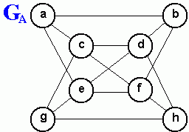
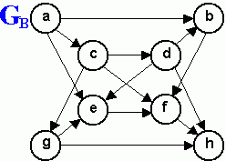
Review Questions
1. Consider a depth-first traversal of the undirected graph G_{A} shown above, starting from vertex a.
List the order in which the nodes are visited in a preorder traversal showing the depth-first traversal tree.
List the order in which the nodes are visited in a postorder traversal
2. Repeat exercise 1 above for a depth-first traversal starting from vertex d.
3. List the order in which the nodes of the undirected graph G_{A} shown above are visited by a breadth first traversal that starts from vertex a, showing the breadth-first traversal tree. Repeat this exercise for a breadth-first traversal starting from vertex d.
4. Repeat Exercises 1 and 3 for the directed graph G_{B}.

